Slide 1
General Distributed Systems Principles

Slide 2
Introduction
Distributed systems have become commonplace in the last 20 years
  Due to the continued increase in CPU power according to Moore's law
  And the vast improvement in network connections
    Both in terms of Local Area Network (LAN) and Wide Area Network (WAN) connections

Slide 3
Definition
“A distributed system is a collection of independent computers that appears to its users as a single coherent system”
  Distributed Systems book by van Steen and Tanenbaum
What are the important consequences of this definition?

Slide 4
Definition Consequences
Components in a distributed system are autonomous
Users and programs only see a single system
No assumption is made about the computing components in the system (i.e. the CPUs could be heterogeneous)
No assumption is made about the network topology or components in the system.

Slide 5
Middleware
  Users and application should be able to interact with each other in a consistent and uniform way
  It should be possible expand and scale the system easily
  Should failures occur, they should be masked/hidden from users.

Slide 6
Middleware
In order to support these features we need middleware
  “a layer of software that is, logically placed between a higher-level layer consisting of applications and users, and a layer underneath consisting of operating systems and basic communication facilities”
Should hide the respective differences between individual nodes and OSes
Diagram on next slide

Slide 7
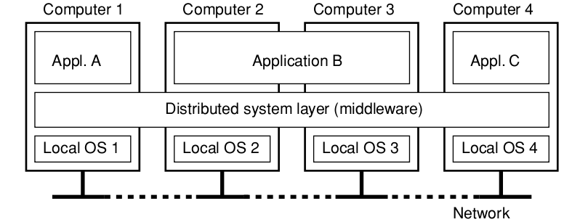
Middleware

Slide 8
Distributed System General Goals
“The main goal of a distributed system is to make it easy for users and applications to access remote resources, and share them in a controlled and efficient way”
  May be more economical to share a resource than replicate it.
    e.g. sharing printers, supercomputers, large scale storage
  However, as sharing increases, security risks increase.
    Prevent eavesdropping, and intrusion in the system

Slide 9
Distribution Transparency
A distributed system must be able to hide the fact that processes and resources are physically distributed across multiple computers
  A distributed system that presents itself to users and applications as if it were a single system is said to be transparent.
  Transparency has many different meanings and aspects
  Thus we will define the different types of transparency within a distributed system

Slide 10
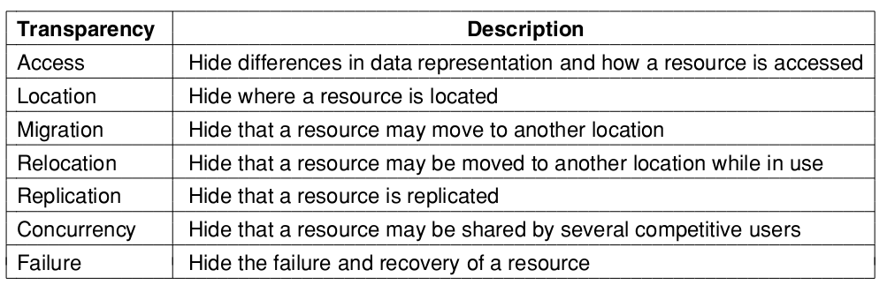
Distribution Transparency

Slide 11
Distribution Transparency
Access transparency: deals with differences in data representation and resource access by users.
  Should hide differences in architectures and data representation
Location transparency: users should not be able to tell where a resource is located.
  Naming services play an important role here. (e.g. DNS)

Slide 12
Distribution Transparency
Migration Transparency: resources can be moved without affecting how those resources can be accessed
  Should not matter if they are close by or on the other side of the world
Relocation Transparency: resources can be relocated while they are being accessed with the user or application noticing
  Much stronger condition than Migration Transparency

Slide 13
Distribution Transparency
Replication Transparency: the system should hide the fact there are multiple copies of the same resource.
  To hide this all replicas should share the same name.
Concurrency Transparency: users should be able to share resources with each other noticing that they are using the same resource
  Will require locking mechanisms particularly around write and update operations

Slide 14
Distribution Transparency
Failure Transparency: the user should not notice that a resource fails to work properly and the system recovers from that failure
  “You know you have a distributed system when the crash of a computer you've never heard of stops you from getting any work done” - Leslie Lamport
Masking failures is difficult and in some cases impossible
  Difficult to differentiate between a slow resource and a failed one.

Slide 15
Distribution Transparency
Considerable care should be taken when deciding on the degree of transparency
  There will be situations where hiding all distribution is not a good idea. (e.g. time zones)
Particularly when WAN networks are involved
  Considerably slower than LAN networks

Slide 16
Openness
“An open distributed system is a system that offers services according to standard rules that describe the syntax and semantics of those services.”
  Services are specified through interfaces, by using an Interface Definition Language (IDL)
  Interface describes the syntax of service
  Not the implementation

Slide 17
Openness
Proper interface definition permits two completely arbitrary processes to communicate regardless of implementation
  Proper specifications are complete and neutral.
  Complete means everything has been specified and neutral means there is no prescription of how the interface should be implemented.
Interoperability measures how well two different systems can co exist and work together

Slide 18
Openness
Portability measures how well an application A can be executed on a different distributed system B without modification while using the same interface as A
  Necessary for process migration to function (e.g. agent systems)
Extensibility measures how easy to add new components to the system
  Without affecting the ones that are already there

Slide 19
Policy and Mechanism
To have a flexible and open distributed system it must be organised as a set of small, replaceable, adaptable components
  Define the high level software parts and the low level hardware units.
  Also should describe how they should function
  Otherwise it will be difficult to change or replace a component (monolithic architecture)

Slide 20
Scalability
Scalability measures how well a system can maintain performance when more resources are added.
  A system should be scalable with respect to its size
  A system should be scalable regardless of physical distance
  A system should be administratively scalable (i.e. as nodes increase it is still easy to manage)

Slide 21
Scalability
Centralised services are those in which a single server offers a particular service in a distributed system.
  While sometimes unavoidable it prevents scalability
  e.g. the storage of highly confidential information
  Bottleneck even if unlimited processing and storage is available on that server.

Slide 22
Scalability
Centralised data is data that is stored in a single location within a distributed system
  Would mean that all nodes link to a single node for data, leading to saturation of network and a choke point.
  DNS is a good example of decentralised data

Slide 23
Scalability
Centralised algorithms, those which require a single node to have all information are also bad for scalability.
  Only decentralised algorithms should be used
Decentralised algorithms have the following properties

Slide 24
Scalability
No machine has complete information about system state
Machines make decisions based only on local information
Failure of one machine does not ruin the algorithm
There is no implicit assumption that a global clock exists

Slide 25
Scalability
synchronous communication makes scaling difficult.
  Also known as blocking communication. Will wait until a reply is received.
Asynchronous communication should be used (if possible)
  Permits nodes to carry on doing work while waiting for replies.

Slide 26
Scalability
Another way of improving scalability is to use distribution
  Splitting a component into smaller parts and spreading them out
For example the Domain Name System
  Each step in a host name is handled by a separate server. Address is resolved by multiple queries

Slide 27
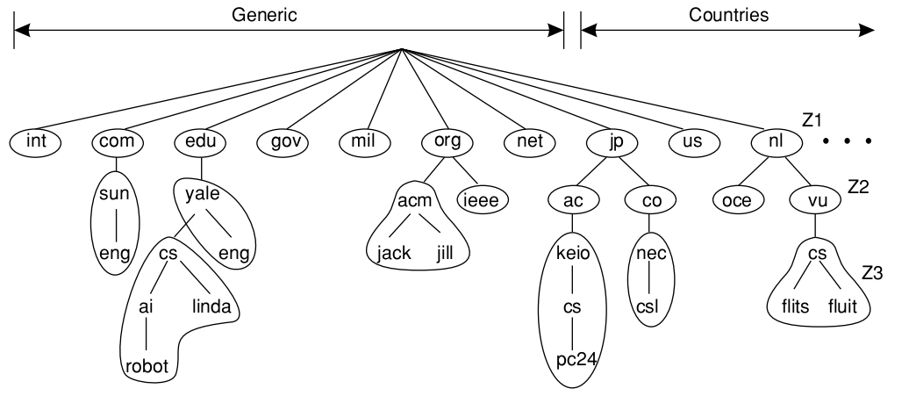
Scalability

Slide 28
Scalability
Another way to improve performance is replication. Making multiple copies of the same resource
  Leads to load balancing and better performance
Caching is similar to replication however caches are often held closer to the client than the original resource
Only difficulty with caching and replication is maintaining consistency

Slide 29
Pitfalls of Distributed Systems
Distributed systems software differs from “normal” software, as there are many components to integrate
  Dispersion must be accounted for
  If you ignore dispersion you will build a system that is needlessly complex and prone to error
  Here is a list of common incorrect assumptions that first time developers encounter

Slide 30
Pitfalls
The network is reliable
The network is secure
The network is homogeneous
The topology does not change
Latency is zero
Bandwidth is infinite
Transport cost is zero
There is only one administrator

Slide 31
Distributed System Types
There are many different types of distributed systems
  But they broadly fall into three categories

Slide 32
Distributed System Types
Distributed Computing Systems are used for high performance CPU intensive tasks
  Examples include cluster computing and grid computing
  Components are generally off-the-shelf commodity parts
  Networks are usually homogenous to make performance predictable and scalable

Slide 33
Distributed System Types
Distributed Information Systems involve data and applications that must be integrated
  The main example of these is distributed transaction systems
  Where multiple clients could access and update data
  The core idea is that a transaction is all or nothing. i.e. it all works or nothing works.

Slide 34
Distributed System Types
For a transaction to work the following four properties must be observed
  Atomic: To the outside world the transaction is indivisible – all or nothing
  Consistent: The transaction does not violate system invariants
  Isolated: Concurrent transactions do not interfere with each other
  Durable: Once a transaction commits, the changes are permanent

Slide 35
Distributed System Types
Distributed Pervasive Systems, include sensor networks and mobile devices. The network is unstable. i.e. devices are moving around or being added and removed constantly
  These systems lack administrative control

